Slide 1


Network & System Administration
Network Monitoring and Troubleshooting

Slide 2
Week | 8th Week
Day
Duration | 4hrs
Agenda
TIME | TOPIC & ACTIVITY | CPMPLETED-
30 Mins | Network monitoring tools and techniques | Yes/No
60 Mins | Network monitoring tools and techniques | Yes/No
15 Mins | Break | Yes/No
45 Mins | Troubleshooting network connectivity issues | Yes/No
30 Mins | Q&A Session on lesson learnt | Yes/No
15 Mins | Break | Yes/No
60 Mins | Performance tuning and optimization | Yes/No
15 Mins | Group Discussion | Yes/No

Slide 3
Learning Objectives
8.1 Network monitoring tools and techniques
8.2 Troubleshooting network connectivity issues
8.3 Performance tuning and optimization

Slide 4
8.1 Network monitoring tools and techniques

Slide 5
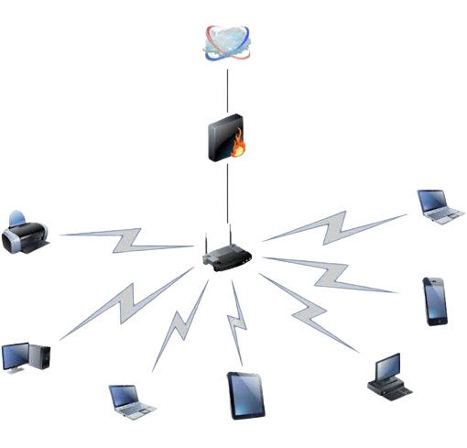
Network Monitoring Techniques
Computer networking is the process of connecting devices so they may exchange data and communicate with one another. There are two options for communication: wired and wireless.

Slide 6
Importance of Network Monitoring and Packet Capture
Network Monitoring: The process of continuously keeping an eye on a network for any reason—such as a system breakdown, slow traffic, a network-related issue, data analytics, etc.—is known as network monitoring. This crucial procedure assists in the discovery, mapping, and monitoring of the network as well as associated hardware and network components, such as servers, switches, routers, and virtual machines (VMs).
Capturing packets: The practice of examining, intercepting, and documenting data packets that are sent or received via a network is known as packet capture. It is a crucial method for traffic management, packet loss tracking, performance analysis, and other tasks. The administrative department can identify vulnerabilities, intrusion detection efforts or attacks, unwanted network behaviors, network congestion, etc. with the aid of packet capturing.

Slide 7
Techniques for Network Monitoring
NetFlow Monitoring: To examine the traffic that flows via a network, this technique captures the packet. After gathering the traffic data, it forwards it to a monitoring tool for examination. To determine how data travels over the network, these are analyzed in terms of volume and traffic flow.
Ping Monitoring: Involves sending a packet to a device and then waiting for a response. If the device responds, it is operating or up; if not, the monitoring tool sends several pings to obtain a response from the device. If this occurs repeatedly, the monitoring tool notifies the user that the device may not be operating properly.

Slide 8
Techniques for Network Monitoring
SQL Query Monitoring: Monitors can utilize SQL queries to keep an eye on the databases that are connected to the network. To get data on the quantity of requests, transmissions, etc., the queries examine the database. Data is sent via a network using the information that has been taken out of the database to respond to all requests, whether they come in or not. The network team's admin department will receive an alert from the motoring tool if it discovers that the database is operating quickly.
SNMP Monitoring: One sort of protocol used to keep an eye on network devices is called Simple Network Management Protocol (SNMP). The SNMP utility monitors network performance by gathering data from network devices. It uses a common language for intercommunication. For network administrators or network monitoring tools to receive the information, the system is dependent upon the agents within the device. The device may broadcast the trap signal if any notable network events take place. An SNMP tool or manager polls the device to find out about its status.

Slide 9
Techniques for Packet Capturing
Port mirroring (SPAN): This technique involves configuring a switch to copy network traffic from one or more ports to a monitoring port. The monitoring port is then connected to a packet capture device, such as a laptop or a dedicated server, to capture and analyze the copied traffic.
TAP (Test Access Point): A TAP is a hardware device that sits between network devices, allowing the monitoring tool to capture a copy of the traffic passing through the TAP. TAPs are often used in high-performance networks where packet loss is not acceptable, as they can provide lossless packet capture.

Slide 10
Techniques for Packet Capturing
Packet capture on a router or switch: Some networking equipment, such as routers and switches, have built-in packet capture capabilities. This method allows you to capture packets directly on the device, eliminating the need for additional hardware or configuration.
Packet capture on a laptop or desktop: This method involves running a packet capture tool, such as Wireshark or tcpdump, on a laptop or desktop computer connected to the network. The tool captures packets from the network interface of the computer, allowing you to analyze the captured traffic.
Mobile device packet capture: In some cases, it may be necessary to capture network traffic from a mobile device, such as a smartphone or tablet. There are packet capture tools available for mobile devices that allow you to capture and analyze network traffic on the go.

Slide 11
Network Monitoring Tools
SNMP (Simple Network Management Protocol) Tools
Tool: SolarWinds Network Performance Monitor
Flow-based Monitoring Tools:
Tool: Cisco NetFlow, nProbe
Tool: Nagios, PRTG Network Monitor
Packet Sniffers:
Tool: Wireshark.
Functionality: Captures and analyzes network packets in real-time, allowing for deep inspection of network traffic and troubleshooting of complex issues.
Network Analyzers:
Functionality: Provides comprehensive monitoring and alerting for network performance, availability, and capacity planning
Functionality: Collects and organizes information from network devices (e.g., routers, switches, servers) to monitor their status and performance.
Functionality: Analyzes flow data to provide insights into traffic patterns and usage, helping to identify congestion and potential security issues.

Slide 12
8.2 Troubleshooting network connectivity issues

Slide 13
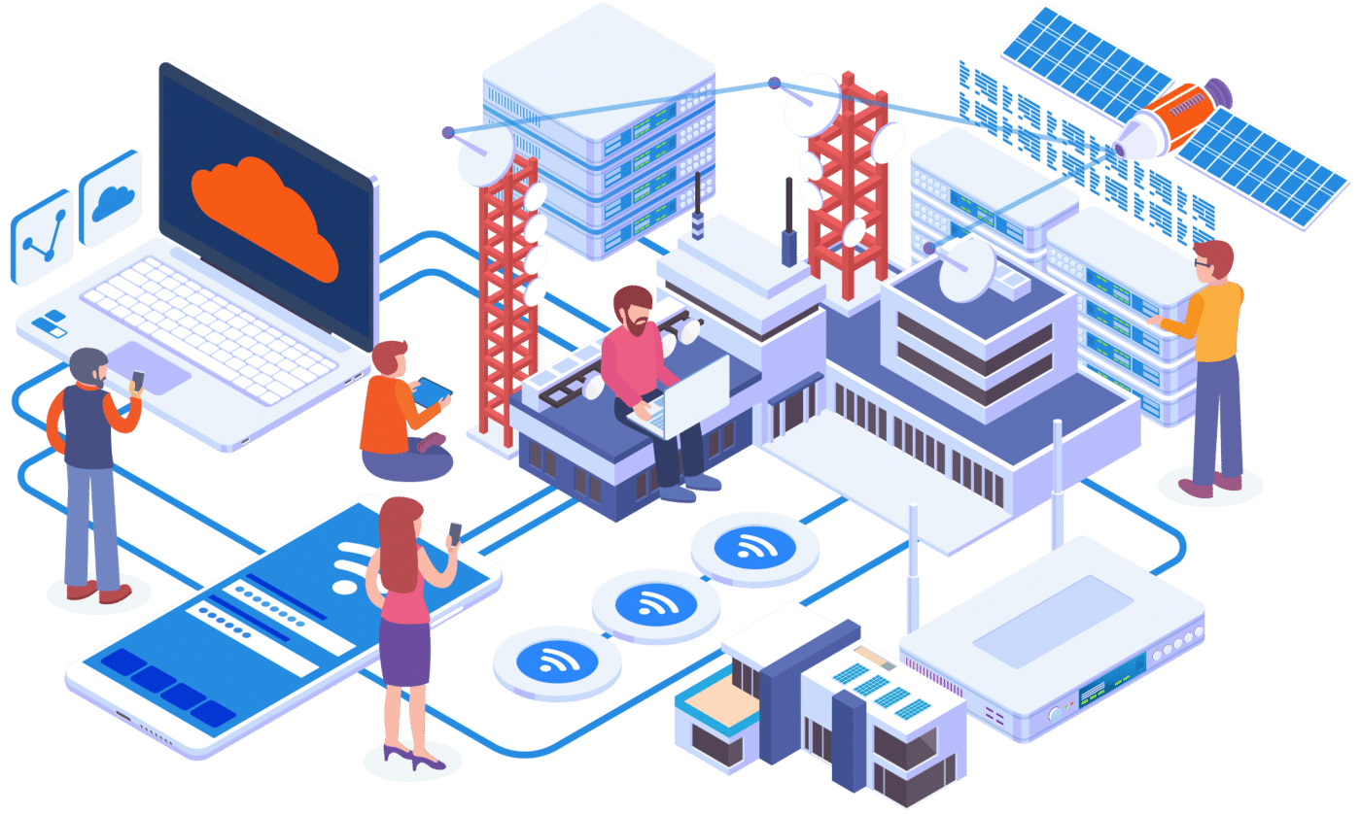
What Is Network Connectivity
The ability of devices, systems, or networks to connect and communicate with one another is referred to as network connectivity. It permits the sharing of resources, data, and information among various entities or devices, usually over a wired or wireless infrastructure.

Slide 14
Network Connectivity Types
Local Area Networks (LANs)
Wide Area Networks (WANs)
Cellular Networks
Satellite Networks
Bluetooth and NFC
Internet of Things (IoT) Connectivity
Cloud Connectivity
Virtual Private Networks (VPNs)
Peer-to-Peer (P2P) Networks
Ethernet and Fiber Optics
Wireless Mesh Networks

Slide 15
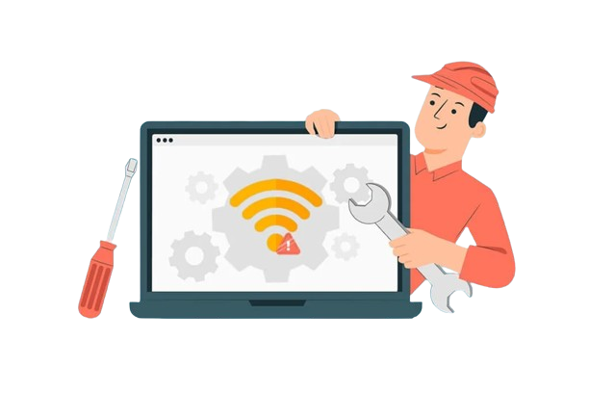
Steps to Troubleshoot a Network Connectivity
Verify the physical connections: of the network devices (routers, switches, etc.) to make sure the wires are firmly attached, and the lights are on.
Check IP Settings: Make sure the device is configured with a working IP address, subnet mask, gateway, and DNS server. To check, use tools such as the ipconfig command (Linux/macOS) or ipconfig (Windows).
Firewall and Security Software: To rule out any blocking concerns, temporarily disable firewalls or security software.

Slide 16

Restarting the router or modem will allow network connectivity to be restored.
Network Diagnostic Tools: To look for anomalies in network traffic, use tools such as Wireshark for network diagnostics.
Speak with ISP: If the problem continues, contact your Internet service provider (ISP) to inquire about any outages or issues they may be experiencing.

Slide 17
Common Connectivity Issues
Physical Connectivity Problems:
Cable faults
Configuration Issues:
Incorrect IP address configuration
Wireless signal interference
Faulty network devices (routers, switches)
DNS problems
Misconfigured network devices
Interference:
Electromagnetic interference (EMI)

Slide 18
Q&Q Session on Lesson learned

Slide 19
Q&Q Session
Q1: What is the primary purpose of network monitoring?
A1: The primary purpose of network monitoring is to continuously observe a network to detect performance issues, failures, and security threats, ensuring network availability and reliability.
Q2: What is SNMP and how is it used in network monitoring?
A2: SNMP (Simple Network Management Protocol) is used to collect and organize information about managed devices on IP networks, allowing network administrators to monitor network performance and detect issues.
Q3: How does packet analysis help in network monitoring?
A3: Packet analysis helps in network monitoring by examining the data packets transmitted over a network, allowing administrators to understand network traffic patterns, detect anomalies, and troubleshoot issues.

Slide 20
Q&Q Session
Q4: What are some common physical connectivity problems?
A4: Common physical connectivity problems include cable faults and faulty network devices such as routers and switches.
Q5: What is Quality of Service (QoS) and why is it important?
A5: Quality of Service (QoS) is a set of techniques to manage network traffic by prioritizing critical applications, ensuring they receive the necessary bandwidth and performance.

Slide 21
8.3 Performance Tuning and Optimization

Slide 22

What is Performance tuning
The process of improving computer, server, and database system performance is known as performance tuning. Slow or unresponsive systems can be signs of a performance issue. High system loading is typically the cause of this, as it pushes a system component to its breaking point.

Slide 23
Impact on end-users
In addition to affecting the system's overall performance, it causes several slow and weak reactions, such as delays in reporting, customer intelligence, business analytics, ETL load/batch job, decision-making, planning and forecasting, and key performance metrics. The more data there is, the worse these issues get, which hurts performance.
Many incorrect behaviors contribute to slow systems, which in turn cause slow system response. Some of the less significant causes are inadequate scheduling and monitoring, human error, and improper and meaningful maintenance. On the other hand, certain issues result from shoddy system architecture. However, most issues arise from poorly crafted SQL, either by users or developers.

Slide 24
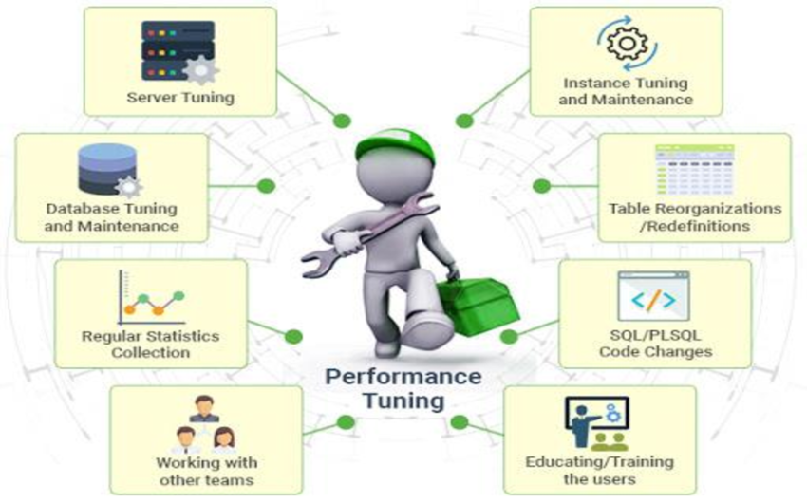
Types of Performance Tuning

Slide 25
Group Discussion
What are the network devices and how to configure.
What is VLANs what the use of Trunking.
What is Virtual Private Networks (VPNs)
What the use of Wireless Network.

